Slide 1
PHYS 304: Lecture 17 (Intro to) Quantum Mechanics
Sept-Dec 2021 Edition
Jeff Young
brimacombe Rm 278, young@phas.ubc.ca

Slide 2
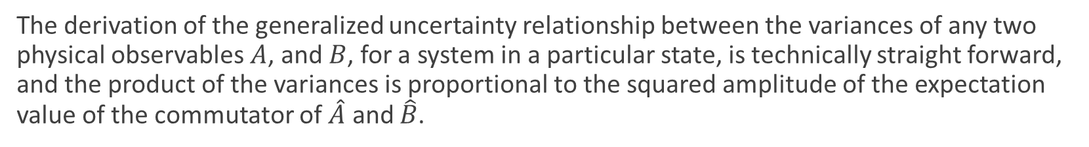

Review of key points from last lecture
By expanding the expectation value of some operator of some observable in the basis defined by the set of eigen states of that same operator, it is clear that the probability of measuring a particular eigen value of that operator is proportional to the squared magnitude of the projection of the state of interest on that eigen state. The generalized statistical interpretation is that if you carry out a measurement of that observable, with sufficient resolution, you must measure one of the eigen values, and the state will be collapsed after the measurement to the corresponding eigen state (discrete spectrum language, must tweak for continuous spectrum).
The derivation of the generalized uncertainty relationship between the variances of any two physical observables $A$, and $B$, for a system in a particular state, is technically straight forward, and the product of the variances is proportional to the squared amplitude of the expectation value of the commutator of $\hat{A}$ and $\hat{B}$.
$σ_{A}^{2}$ $σ_{B}^{2}≥{\left(\frac{1}{2i}\left\langle \left[\hat{A}, \hat{B}\right]\right\rangle \right)}^{2}$

Slide 3
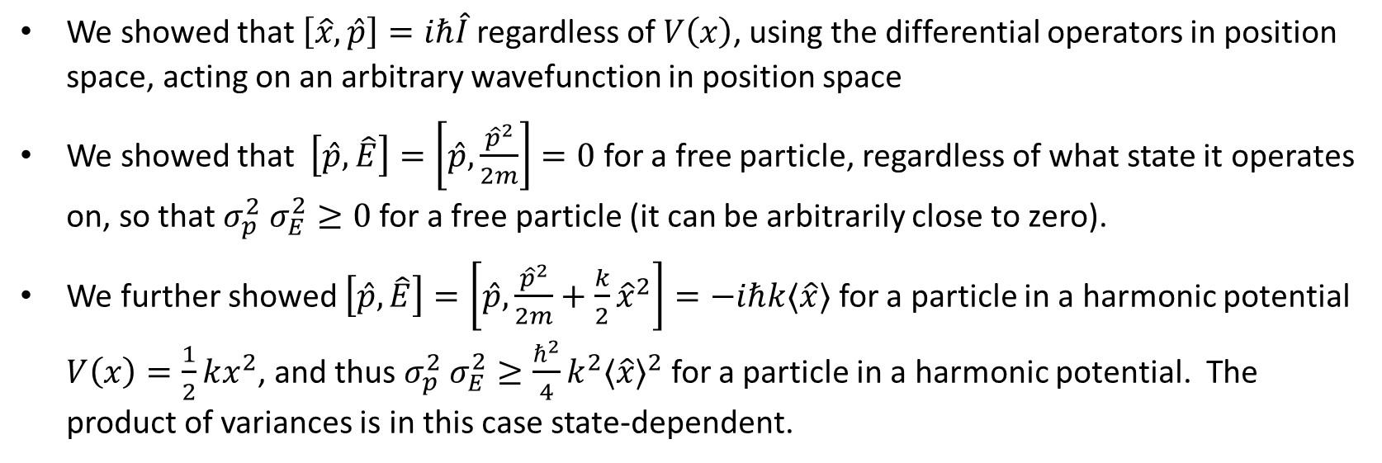
Review of key points from last lecture
We showed that $\left[\hat{x},\hat{p}\right]=iℏ\hat{I}$ regardless of $V\left(x\right)$, using the differential operators in position space, acting on an arbitrary wavefunction in position space
We showed that $\left[\hat{p},\hat{E}\right]=\left[\hat{p},\frac{{\hat{p}}^{2}}{2m}\right]=0$ for a free particle, regardless of what state it operates on, so that $σ_{p}^{2}$ $σ_{E}^{2}≥0$ for a free particle (it can be arbitrarily close to zero).
We further showed $\left[\hat{p},\hat{E}\right]=\left[\hat{p},\frac{{\hat{p}}^{2}}{2m}+\frac{k}{2}{\hat{x}}^{2}\right]=−iℏk⟨\hat{x}⟩$ for a particle in a harmonic potential $V\left(x\right)=\frac{1}{2}kx^{2}$, and thus $σ_{p}^{2}$ $σ_{E}^{2}≥\frac{ℏ^{2}}{4}k^{2}{⟨\hat{x}⟩}^{2}$ for a particle in a harmonic potential. The product of variances is in this case state-dependent.
Notes:
Very Different!

Slide 4
Today: Finish Chapter 3
Some interpretation of the generalized uncertainty relation
The energy-time uncertainty relation

Slide 5
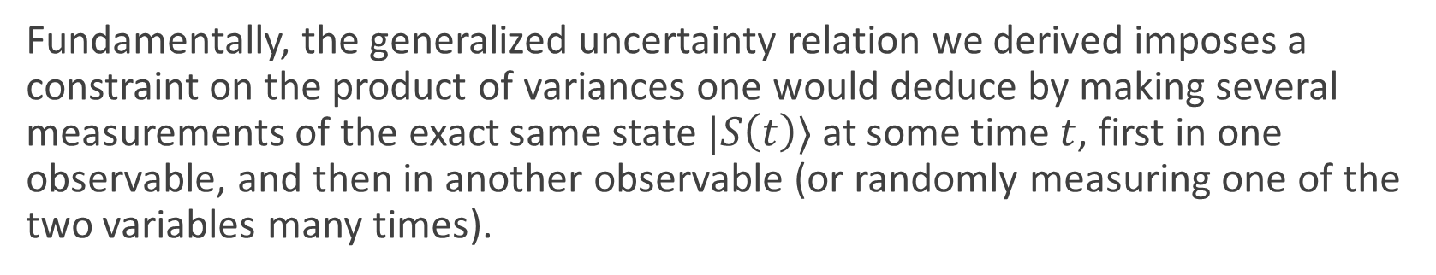
Discussion
Fundamentally, the generalized uncertainty relation we derived imposes a constraint on the product of variances one would deduce by making several measurements of the exact same state $|S\left(t\right)⟩$ at some time $t$, first in one observable, and then in another observable (or randomly measuring one of the two variables many times).
It does NOT imply anything, in general, about the product of those variances at any other time
It does NOT imply anything, directly, about what happens if you try to measure two quantities at the same time (a very complicated process, in general).
The constraint IS an inequality, NOT an equality!

Slide 6

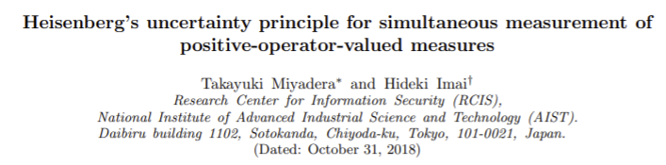
Further reading

Slide 7
Lets ponder the results from last lecture
POLL #1: Which of the following statements follows from what we have learned about the uncertainty principle so far?
If two observables share the same set of eigen states, the variance of measurements of at least one of those observables must be zero for a particle in any state (T/F)
If two observables share the same set of eigen states, it is possible that there are states for which repeated measurements of each observable would result in arbitrarily small variance in both measurements (T/F)
If the commutator of two observables is proportional to the identity operator, it is impossible to find a state in which the variance in the measurement of one observable is arbitrarily small (T/F)
The minimum value of the product of variances for two observables for a particle in some state must be independent of time (T/F)
If two operators do not commute, and their commutator is state-independent, if you try to manufacture a state that has very small variance in one of the observables, then as you decrease that variance, the minimum possible variance of the other observable must increase (T/F)
Notes:
Last most relevant

Slide 8

The minimum uncertainty state:
$σ_{x}$ $σ_{p}≥ℏ/2$
What state satisfies the equality condition (the “minimum uncertainty state”?)
See text Section 3.5.2 for discussion/derivation
$ψ\left(x\right)=Ae^{−a{\left(x≺x>\right)}^{2}} e^{i<p>\frac{x}{ℏ}} ,$where $⟨x⟩ \& ⟨p$ $⟩$ are real constants.
Is this familiar?
This is our old gaussian wavepacket!

Slide 9

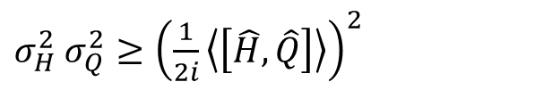
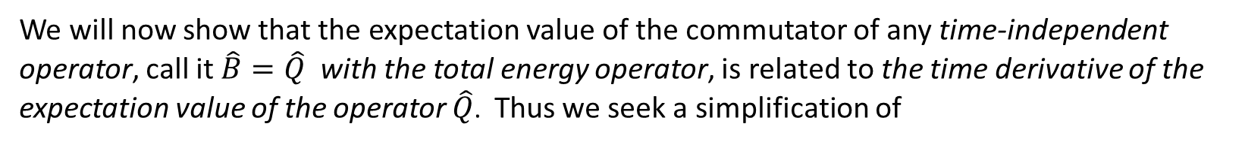
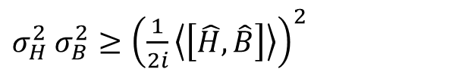
What happens if we make $\hat{A}=\hat{E}=\hat{H}$?
$σ_{H}^{2}$ $σ_{B}^{2}≥{\left(\frac{1}{2i}\left\langle \left[\hat{H}, \hat{B}\right]\right\rangle \right)}^{2}$
We will now show that the expectation value of the commutator of any time-independent operator, call it $\hat{B}=\hat{Q}$ with the total energy operator, is related to the time derivative of the expectation value of the operator $\hat{Q}$. Thus we seek a simplification of
$σ_{H}^{2}$ $σ_{Q}^{2}≥{\left(\frac{1}{2i}\left\langle \left[\hat{H}, \hat{Q}\right]\right\rangle \right)}^{2}$
under the constraint that$\left\langle \left(\frac{∂}{∂t}\hat{Q}\right)\right\rangle =0.$ NOTE: $\left\langle \left(\frac{∂}{∂t}\hat{Q}\right)\right\rangle ≠\frac{d}{dt}\left\langle \hat{Q}\right\rangle$
Notes:
NOTE: subtle but very important distinction!

Slide 10

Simplification
Step 1: Expand $\frac{d}{dt}\left\langle \hat{Q}\right\rangle$
Step 2: Use the fact that $\frac{∂}{∂t}|S\left(t\right)⟩=\frac{−i}{ℏ}\hat{H}|S\left(t\right)⟩$, and our constraint that$\left\langle \left(\frac{∂}{∂t}\hat{Q}\right)\right\rangle =0$to simplify

Slide 11

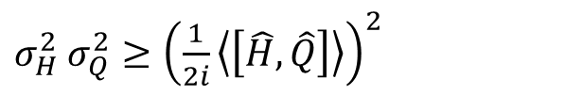

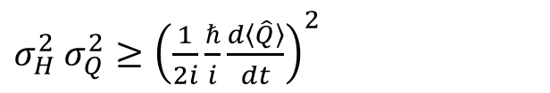
And finally …
$$\frac{d}{dt}\left\langle \hat{Q}\right\rangle =\frac{i}{ℏ}\left\langle \left[\hat{H}, \hat{Q}\right]\right\rangle$$
$σ_{H}^{2}$ $σ_{Q}^{2}≥{\left(\frac{1}{2i}\left\langle \left[\hat{H}, \hat{Q}\right]\right\rangle \right)}^{2}$
together with
imply
$σ_{H}^{2}$ $σ_{Q}^{2}≥{\left(\frac{1}{2i}\frac{ℏ}{i}\frac{d\left\langle \hat{Q}\right\rangle }{dt}\right)}^{2}$
$$σ_{H}σ_{Q}≥ℏ/2 |d⟨\hat{Q} ⟩/dt)|$$

Slide 12

What does this tell us?
The direct, or fundamental connection between the generalized uncertainty relation and the energy-time uncertainty relation is through the proportionality of the product of the variances of the energy operator and any other Hermitian operator, with the rate of change of the expectation value of the Hermitian operator of interest.
The variance in the energy of some state at any given time must be greater than or equal to the normalized rate of change of any Hermitian observable in that state.
$$σ_{H}σ_{Q}≥ℏ/2 |d⟨\hat{Q} ⟩/dt)|$$

Slide 13
Lets ponder these results
POLL #3: Which of the following statements is true and which is false?
a) The variance in the energy of a state at some particular time depends on the other observable with which you might be comparing variances. (T/F)
b) If the variance of the energy of a state at some particular time is very small, then the normalized rate at which any observable can vary at that time must be very slow. (T/F)
c) If any observable has a very fast normalized rate of change at some particular time, then the variance of the energy at that time must be very large. (T/F)
Notes:
b) Makes sense with notion of a “stationary state”!

Slide 14
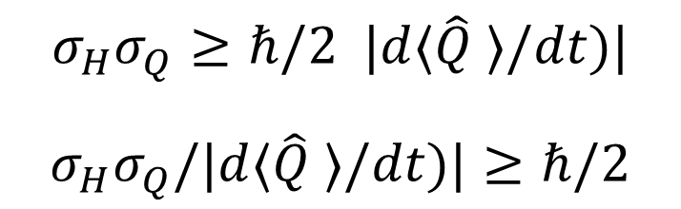

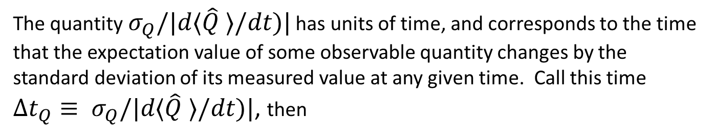
Convert the rate into a time?
$$σ_{H}σ_{Q}≥ℏ/2 |d⟨\hat{Q} ⟩/dt)|$$
$$σ_{H}σ_{Q}/|d⟨\hat{Q} ⟩/dt)|≥ℏ/2$$
The quantity $σ_{Q}/|d⟨\hat{Q} ⟩/dt)|$ has units of time, and corresponds to the time that the expectation value of some observable quantity changes by the standard deviation of its measured value at any given time. Call this time
${Δt_{Q}≡ σ}_{Q}/|d⟨\hat{Q} ⟩/dt)|$, then
$$σ_{H}Δt_{Q}≥\frac{ℏ}{2}≡ΔEΔt_{Q}≥\frac{ℏ}{2}$$
For any time-independent physical observable operator $\hat{Q}$
Notes:
Note: text does not add subscript, which can lead to confusion.

Slide 15

Reflect on our results from last day:
For a particle in a harmonic potential:
For a free particle:
Free particle: Key point is that it is possible (not necessary) for variances of both to be arbitrarily close to zero (consistent with sharing eigen bases)
Harmonic oscillator: key points are that:
Product of variances is state dependent, and in general not equal to zero (consistent with not sharing common eigen states)
Since it is state dependent, it is also in general time-dependent
Beyond this, not so easy to interpret from the generalized uncertainty relation alone
Notes:
Key points are that is
state dependent, and therefore in general time-dependent
in general not equal to zero (consistent with not sharing common eigen states)
Beyond this, not so easy to interpret

Slide 16


Discuss:
Does the energy-time analysis of the product of variances add any useful insight to this comparison of the free particle and the oscillator result for $σ_{H}σ_{p}$?
Notes:
If momentum is changing rapidly (relative to variance of momentum), then this implies that there must be quite a bit of uncertainty in measurements of the energy at that time.
Think through for a wavepacket that mimics the classical motion of a particle in a harmonic potenital…(momentum zero when probability density close to classical turning points, and a maximum in centre, when probability distribution is symmetric). So rate of change of momentum large at extremes, and zero in middle…is this consistent with our formula?

